Slide 1
The Adventurous Project of building a processor
A Presentation By TEAM 2: Nate Doher, molly A. lee, & Shea winkler
CSCE 230: Computer organization
university of Nebraska- lincoln
29th November 2017

Slide 2
Objectives
The
Processor that could Implement a
Goal of Our
Project was to Create a
Subset of the NIOS II Architecture and Some
Features Unique to ARM-Like Conditional Executions

Slide 3
outline
Our project was split into 7 phases, each of which was vital to the success of the overall project.
Phase 1: Register File, ALU, & Control Unit
Phase 2: Data Path & R-Type Instructions
Phase 3: Remaining Instructions, Memory Interface, & Instruction Address Generator
Phase 4: I/O & ARM-like Conditional Execution
Phase 5: (Bonus) Additional I/O & J-type Instructions
Phase 6: Design Doc, Presentation, Demo
Phase 7: (Bonus) Assembler

Slide 4
Phase 1: what we tried to accomplish
Create a Register File
16x16 bit
Create an ALU
16 bit
Start Building a Control Unit
Used for setting the flag values that affect the way the processor functions
Notes:
Control Unit was used for setting flag values that affect the way in which the processor functions. Phase II will implement the control unit to initialize a functioning processor.

Slide 5
Phase 1: what We actually did
Create a Register File
This was completed in Lab 7.
Create an ALU
This was completed in Lab 6.
Start Building a Control Unit
The template for this was provided by the TA’s in Lab 9.
Notes:
Control Unit was used for setting flag values that affect the way in which the processor functions. Phase II will implement the control unit to initialize a functioning processor.

Slide 6
Phase 1: difficulties that arose
We used Molly’s ALU and Nate’s Register File in the Project.
Some of the components (muxes, decoders, etc.) were mapped differently, which caused issues with compiling.
We resolved this issue by changing the way we used Port Maps in the ALU, as well as the order of inputs and outputs in the ALU.

Slide 7
Phase 2: what we tried to accomplish
Create a Data Path
Create and Compile a Basic Processor
Begin Implementing R-type Instructions:
Addition (Add)
Subtraction (Sub)
Logical And (And)
Logical Or (Or)
Exclusive Or (Xor)
Notes:
In Phase II, Team 2 created the Data Path File for the project and compiled a basic processor for the first time. In this phase, it was only necessary to implement Register-type (R-type) instructions. This was the simplest version of the processor that functions. The successive phases have been built from the working product of this phase.

Slide 8
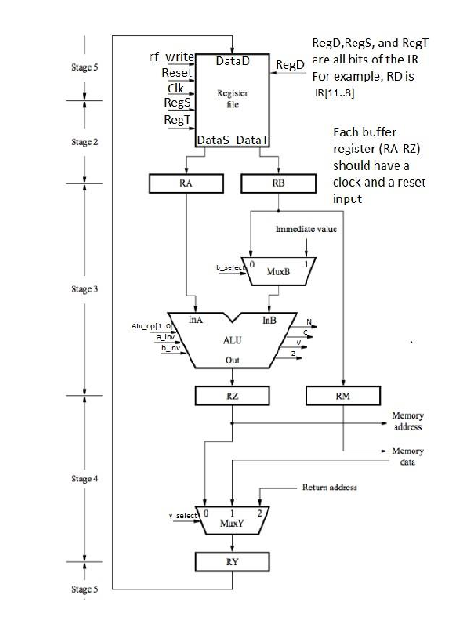
Phase 2: what we actually did
Created a Data Path
Created and Compiled a Basic Processor
Implemented the R-type Instructions that Used the ALU:
Addition (Add)
Subtraction (Sub)
Logical And (And)
Logical Or (Or)
Exclusive Or (Xor)

Slide 9

Phase 2: difficulties that arose
Starter code for the Control Unit was provided in Canvas.
It was easy to implement the needed R-type instructions.
We did not run into any major problems in Phase 2.
Notes:
Since much of the starter VHDL code for Phase 2’s Control Unit was provided to us from the TA’s in Canvas, it was easy to implement the needed R-type instructions during the lab period.
We did not run into any major problems in Phase 2.

Slide 10
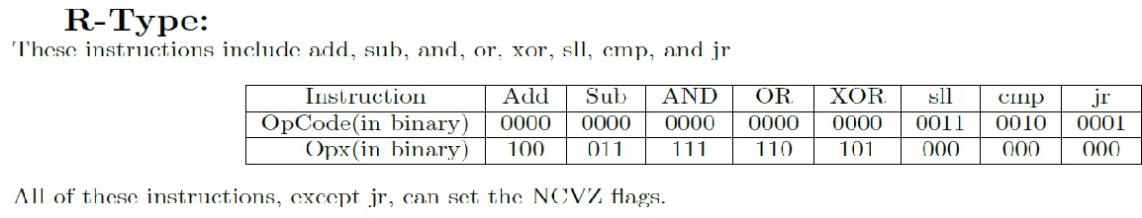
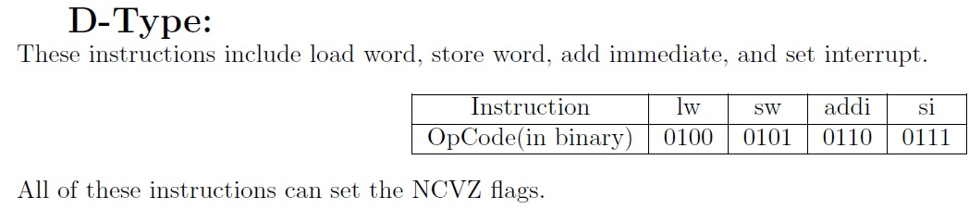
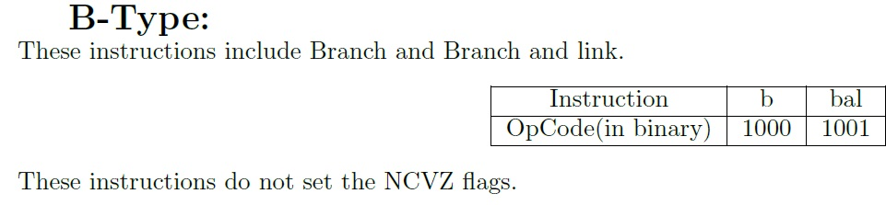
Phase 3: what we tried to accomplish
Implement the Remaining Instructions:
R-type:
Jump Register (JR)
Compare (CMP)
D-type:
Load Word (LW)
Store Word (SW)
Add Immediate (Addi)
B-type:
Branch (Br)
Branch and Link (BAL)
Notes:
In Phase III, Team 2 modified the Data Path and the Control Unit to add new R-type, D-type and B-type instructions, including JR, CMP, LW, SW, ADDI, B and BAL. Team 2 also integrated the memory interface and instruction address generator into the existing processor in this phase. Phase IV will build off Phase III and implement I/O.

Slide 11
Phase 3: what we tried to accomplish
Memory Interface:
Implement Memory Interface and all provided components into the Data Path.
Instruction Address Generator (IAG):
Implement IAG and all provided components into the Data Path.
Notes:
In Phase III, Team 2 modified the Data Path and the Control Unit to add new R-type, D-type and B-type instructions, including JR, CMP, LW, SW, ADDI, B and BAL. Team 2 also integrated the memory interface and instruction address generator into the existing processor in this phase. Phase IV will build off Phase III and implement I/O.

Slide 12
Phase 3: what we actually did
Remaining Instructions:
The rest of the R-type, D-type and B-type instructions were added.
The Memory Interface:
Implemented into the Data Path.
The provided components included: Adder, Const, InstructionAddressGenerator, MainMemory, MemoryInitialization.mif, MemoryInterface, MuxINC, MuxPC, PC and PC_temp.
A .do File and .mif File were created to test the Memory Interface.
The Instruction Address Generator (IAG):
Implemented into the Data Path.
Needed a new mux named MuxMa.
MuxMa selects either from the register RZ or the IAG.
Notes:
The rest of the R-type, D-type and B-type instructions were added.
The Memory Interface was implemented into the Data Path. The provided components for Phase III included: Adder, Const, InstructionAddressGenerator, MainMemory, MemoryInitialization.mif, MemoryInterface, MuxINC, MuxPC, PC and PC_temp. All of these files were found in the memFilesProcessor.zip file on Canvas. Team 2 solely had the responsibility of downloading and integrating these components into the Data Path, as well as updating some of these components to meet the checkoff requirements.
A .do File and .mif File were created to test the Memory Interface.
The Instruction Address Generator was implemented into the Data Path. The components were given as block diagram components. By using the component generator, the inputs and outputs were then able to be mapped to the Data Path in order for the Instruction Address Generator to be initialized. To fully connect the Instruction Address Generator and new Mux was needed named MuxMa. MuxMa selects either from the register RZ or the Instruction Address Generator.

Slide 13

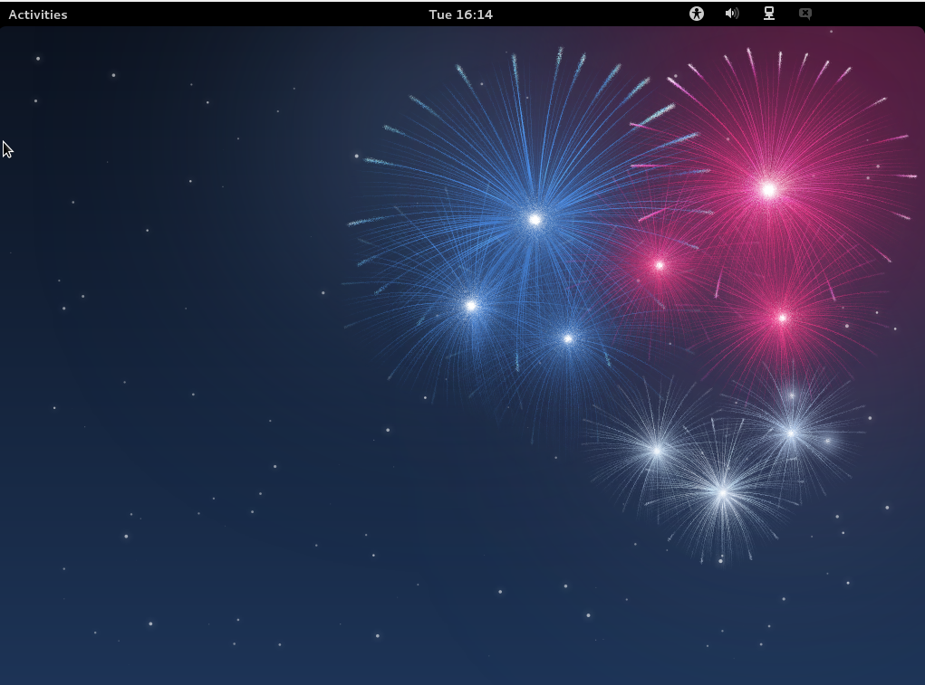
Phase 3: difficulties that arose
We kept getting red lines on ModelSim using Nate’s computer.
When we switched to Shea’s computer, it miraculously worked!

Slide 14
Phase 4: what we tried to accomplish
Implement Basic I/O:
Pushbuttons
Slider Switch (SW)
Green LEDs (LEDG)
ARM-like Conditional Execution:
Branch on Equals (BEQ)
Notes:
The main purpose of Phase IV was to add basic I/O and ARM-like execution [2].

Slide 15
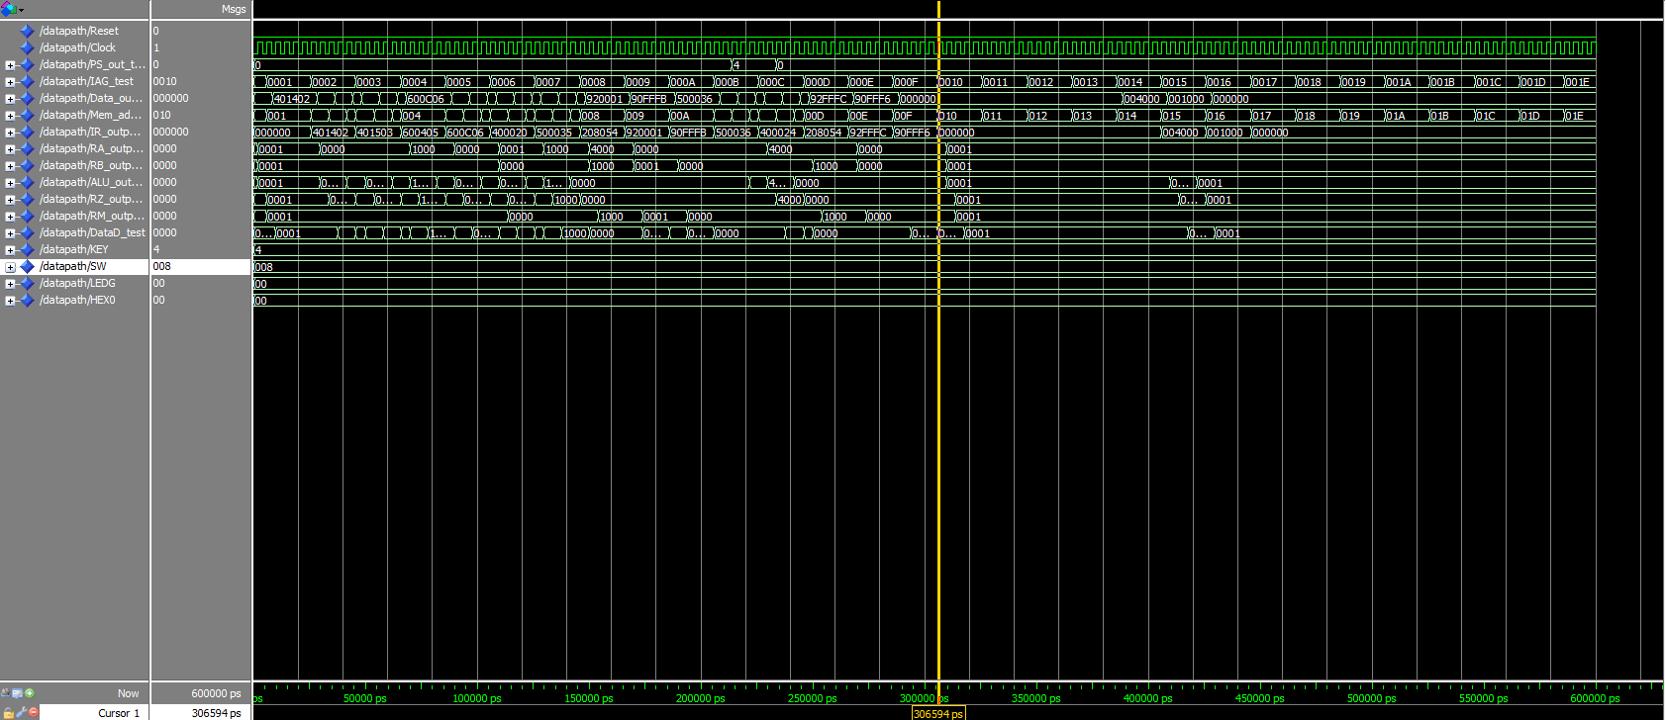
Phase 4: what we Submitted (20 Nov. 2017)
No Branch!
No
Branch-and-Link!
Bitmap Submitted

Slide 16
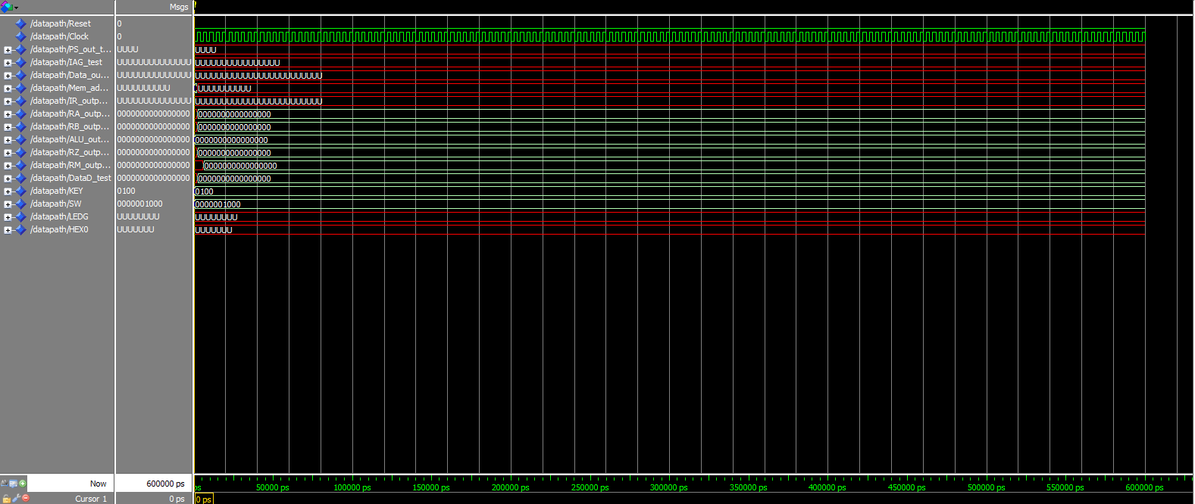
Phase 3 & 4: difficulties that arose
Using RTL Simulation instead of Gate Level Simulation…(oops)
SO MANY RED LINES!!!

Slide 17
Phase 5: what we tried to accomplish
Extending I/O
Hex1, Hex2, Hex3
Red LEDs (LEDR)
Adding J-type instructions:
Jump (J)
Jump and Link (JAL)
Load Immediate (LI)

Slide 18
Phase 5: what we actually did
Absolutely Nothing =(
Since we did not figure out how to implement I/O in Phase 4, we did not have the capability to attempt the extra I/O in Phase 5.

Slide 19


Phase 5: difficulties that arose
(We couldn’t figure out Phase 4.)

Slide 20
Phase 6: what we tried to accomplish
Finish Phase IV (finally)!
Write the Written Report: Our Design Doc
Develop this (Oh-So Lovely) Presentation
Try to Come Up With Some Sort of Demonstration?

Slide 21
Phase 6: what we actually did
It’s Branching! But in an Infinite Loop Back to Instruction 5…..

Slide 22
Phase 6: what we actually did
Now we have all 14 instructions!
(But no LEDG) =(

Slide 23
Phase 6: What we actually did
Realized that we had the wrong values selected for MuxC for the R-type and D-type instructions.
Affected LW and SW instructions, as well as any of the instructions that used the ALU.
Also had issues with pc_enable and pc_select, which once “fixed,” changed the instructions from the IAG.
D-type immediate values take 7 bits but B-type immediate values take 16 bits, so we had to change mux_inc_select to IRoutput (15 downto 0) instead of immediate (6 downto 0)

Slide 24
Phase 6: What we actually did
The problem was that the Immediate value that updates the PC was giving a value of 0x007F and Team 2 had no idea where this value was coming from to later realize that the team had set ps_enable to ‘0’ in stages 4 and 5 instead of setting pc_enable to ‘0’ in stages 4 and 5 of the datapath.
We wanted it to branch from instruction 9 back to instruction 5 and eventually go from instruction 8 to the LED loop, but instead we eventually got it to branch from instruction 10 back to instruction 5 and it got trapped in an infinite loop.
We added more signals in the hopes that this would help us to realize the core issue that is preventing our I/O from working properly.
Notes:
Towards the end of the project, we realized that we had the wrong values selected for MuxC for the R-type and D-type instructions.
This affected LW and SW instructions, as well as any of the instructions that used the ALU. We also had issues with pc_enable and pc_select, which once “fixed,” changed the instructions from the IAG.
We then had to change the mux_inc_select to IRoutput (15 downto 0) instead of immediate, because there were two different values for the immediate.
The problem was that the Immediate value that updates the PC was giving a value of 0x007F and Team 2 had no idea where this value was coming from to later realize that the team had set ps_enable to ‘0’ in stages 4 and 5 instead of setting pc_enable to ‘0’ in stages 4 and 5 of the datapath.
We wanted it to branch from instruction 9 back to instruction 5 and eventually go from instruction 8 to the LED loop, but instead we eventually got it to branch from instruction 10 back to instruction 5 and it got trapped in an infinite loop.
We added more signals in the hopes that this would help us to realize the core issue that is preventing our I/O from working properly.

Slide 25
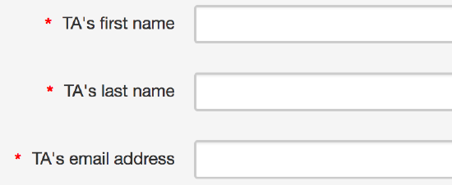
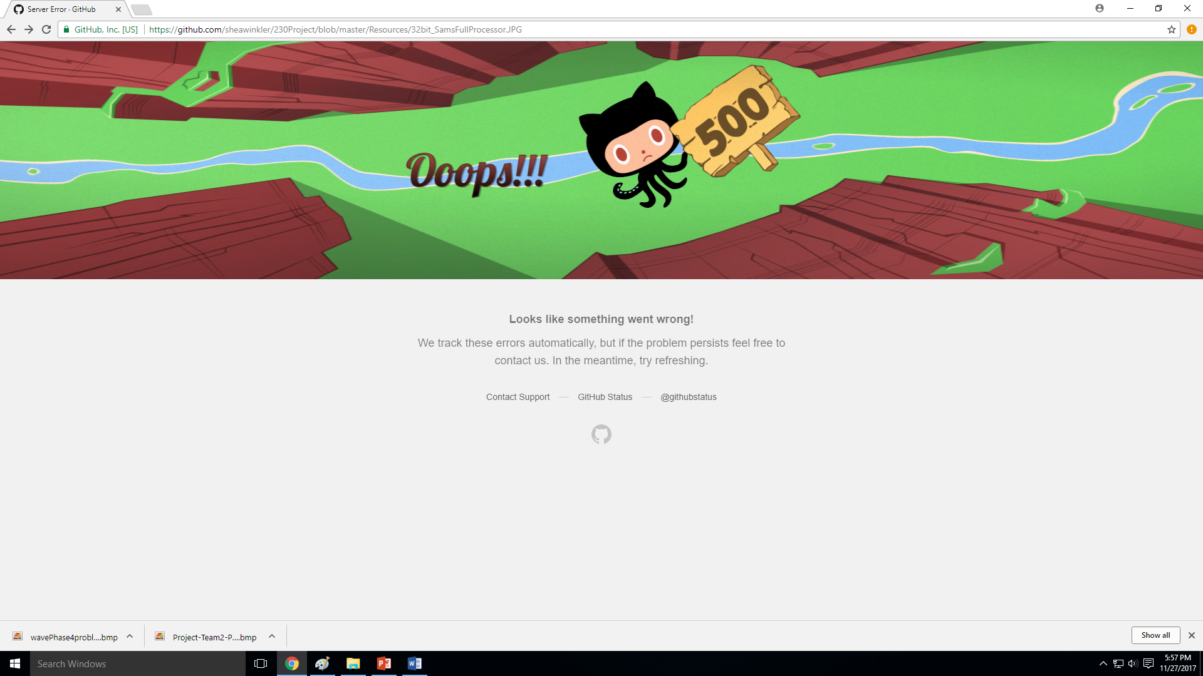


Phase 6: difficulties that arose
Notes:
Github was down for a few minutes on Monday night.
Red lines using RTL simulation.
So Many Questions.
Who are the TA’s?
Where are the TA’s?

Slide 26
PHASE 7: BONUS MATERIAL
For the Bonus Material, we developed an Assembler.
It converts Assembly Code to Machine Code in a MIF file.
Our Assembler can interpret R-type, D-type, & B-type instructions.

Slide 27
REcap
The goal of our project was to create a processor that could implement a subset of the NIOS II Architecture and some features unique to ARM.
In Phase 1, we created the Register File, ALU, & Control Unit.
In Phase 2, we implemented the Data Path & R-Type Instructions.
In Phase 3, we implemented the Remaining Instructions, Memory Interface, & IAG
In Phase 4, we implemented I/O & ARM-like Conditional Execution.
In Phase 5, we had the option to do more I/O & J-type Instructions.
In Phase 6, we created the Final Design Doc, Presentation, & Demo.
In Phase 7, we created an Assembler for Bonus Points.

Slide 28
Final result
We got the processor to implement basic R-type functions, but had difficulties with some D-types such as Addi and some B-types such as Branch.
Towards the end, we did get the program to Branch, but it wasn’t Branching correctly.
We haven’t yet figured out how to implement I/O for Phase 4 and 5 with our processor, but we have not given up hope.

Slide 29
References
[1] Lab 9 – Control Unit. (2017). Retrieved 18 October, 2017, from https://canvas.unl.edu/courses/19800/files/folder/Lab/Week%209?preview=1207084
[2] CSCE 230 Project Overview. (2017). Retrieved 25 October, 2017, from https://canvas.unl.edu/courses/19800/files/folder/Project/Overview%20and%20Helpful%20docs?preview=1285596
[3] CSCE 230 Project Part II Datapath implementation. (2017). Retrieved October 25, 2017, from https://canvas.unl.edu/courses/19800/files/folder/Project/Part%202?preview=1245925
[4] CSCE 230 Project Part III Memory and instruction implementation. (2017). Retrieved November 5, 2017, from https://canvas.unl.edu/courses/19800/files/folder/Project/Part%203?preview=1285586
[5] CSCE 230 Project Part IV Adding I/O and ARM-like Conditional Execution. (2017). Retrieved November 15, 2017, from https://canvas.unl.edu/courses/19800/files/folder/Project/Part%204?preview=1353550
[6] CSCE 230 Project Part V Extending I/O and adding J-type instructions. (2017). Retrieved November 26, 2017, from https://canvas.unl.edu/courses/19800/files/folder/Project/Part%204?preview=1353550
[7] CSCE 230 Project Part VI Final Project, Written Report, Oral Presentation and Demonstration. (2017). Retrieved November 26, 2017, from https://canvas.unl.edu/courses/19800/files/folder/Project/Part%205%20%26%206?preview=1397677

Slide 30
Images
https://goo.gl/sKMZgC
https://gadflyonthewallblog.files.wordpress.com/2017/11/teachers-wanted_slide-f490f6ba4043bb11d14c641c5fd6a253f638a74b-s900-c85.jpg
https://cdn.lynda.com/course/477451/477451-636198978267245657-16x9.jpg
https://cdn0.iconfinder.com/data/icons/iwindows-by-wwalczyszyn-d3dwi6l/512/Computer2.png
https://upload.wikimedia.org/wikipedia/commons/b/b4/Beefy_Miracle.png
http://images.clipartpanda.com/disinformation-clipart-hooray.png
https://www.vectorico.com/download/Social-media/facebook-sad.png
http://ustutorials.com/includes/images/questions-answers.png
https://www.501commons.org/blog/questions.png
https://pixabay.com/p-2758705/?no_redirect

Slide 31
We would like to thank:
Aaron Johnson
Quinn Lanik
Jianfei Shao
Matt Bennett
Samuel Hansen
Tyler Bienhoff
Dr. Witty Srisa-an
Dr. Riedesel
Michael Fay

Slide 32



Questions?

